Slide 1
Deep Learning in Autonomous Driving
Direct Perception Approach
Timo Bergerbusch
Seminar
am Lehrstuhl für Software Engineering
RWTH Aachen

Slide 2
Overview
1.
(Convolutional) Neuronal Nets
2.
Current Approaches
3.
Direct Perception Approach
4.
Deep Learning Languages
5.
Training and Test
6.
Summary

Slide 3
(Convolution) Neural Nets
neural net: 3 layer-types
convolutional:
multiple Hidden-Layer (deep)
different layers:
fully-connected
not fully-connected
…
Input
hidden
output
Notes:
Neural nets:
Simple principle: neurons with weighted sum – bias
Organized in layers
Training = adjusting the weights and biases
Conv. NN:
More than 1 hidden layer
Different layer types:
Fully-connected
Convolution: feature detection considering scale, rotate (shared weights -> more efficient)
Pooling: reduction of input
ReLU: mathmatical normalization
AlexNet: used in the approaches given

Slide 4

(Convolution) Neural Nets
neural net: 3 layer-types
convolutional:
multiple Hidden-Layer (deep)
different layers:
fully-connected
not fully-connected
convolution
-1*7 = -7
2*6 = 12
2*6 = 12
0*9 = 0
7
6
5
5
17
22
7
6
9
1
3
-1
2
20
-5
9
$Σ$ 17
4
1
2
8
2
0
2
21
20
2
9
3
1
Notes:
Convolution:
Based on biology: frontal cortex reacting to stimuli in special field
feature detection considering
Scale
Rotate
Position
Set of features -> set of filtered images
shared weights -> more efficient

Slide 5
(Convolution) Neural Nets
neural net: 3 layer-types
convolutional:
multiple Hidden-Layer (deep)
different layers:
fully-connected
not fully-connected
convolution
ReLu
17
22
7
17
22
7
20
-5
9
ReLu
20
0
9
2
21
20
2
21
20
Notes:
Rectified Linear Unit (ReLU):
mathmatical normalization

Slide 6
(Convolution) Neural Nets
neural net: 3 layer-types
convolutional:
multiple Hidden-Layer (deep)
different layers:
fully-connected
not fully-connected
convolution
ReLu
Pooling
17
22
7
22
9
20
0
9
max. pooling
21
20
2
21
20
Notes:
Neural nets:
Simple principle: neurons with weighted sum – bias
Organized in layers
Training = adjusting the weights and biases
Conv. NN:
More than 1 hidden layer
Different layer types:
Fully-connected
Convolution: feature detection considering scale, rotate (shared weights -> more efficient)
Pooling: reduction of input
ReLU: mathmatical normalization
AlexNet: used in the approaches given

Slide 7
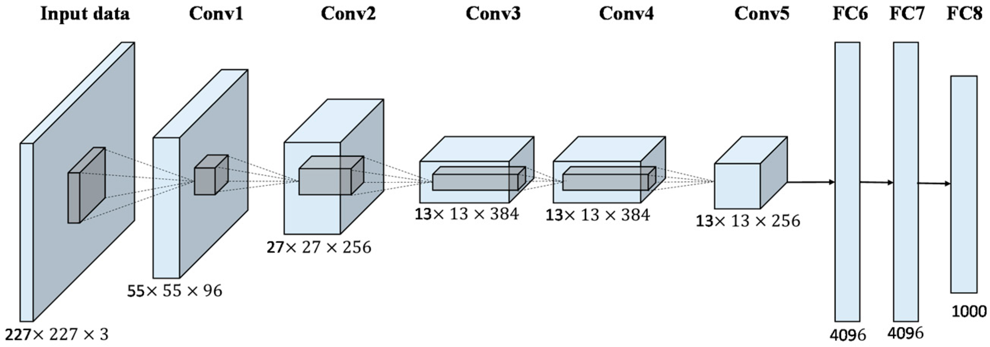
Important Structure
Alex-Net:
ReLu and Pooling
Notes:
Alex-Net:
Best performing 2012
Input -> 5 conv -> 3 fully-connected

Slide 8
Overview
1.
(Convolutional) Neuronal Nets
2.
Current Approaches
3.
Direct Perception Approach
4.
Deep Learning Languages
5.
Training and Test
6.
Summary

Slide 9
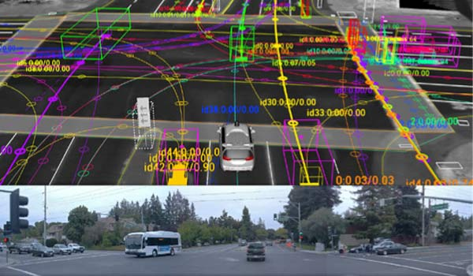
Current Approaches: mediated perception
multi-components
internal 3D-model
problems:
complex
irrelevant/redundant data
Components still research topics themselves
Possible individual components
Abrasion-detection
Pedestrian-detection
Distance-measures
Lane-detection
Vehicle-detection
Veloctiy-measures
Notes:
Mediated perception:
Mutli component complex system
Internal 3D model
Problems as given
=> Reasonable and sturdy approach but lacks flex. and efficiency

Slide 10
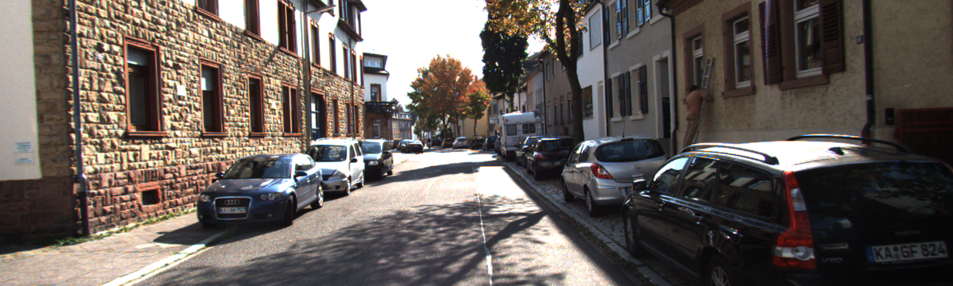
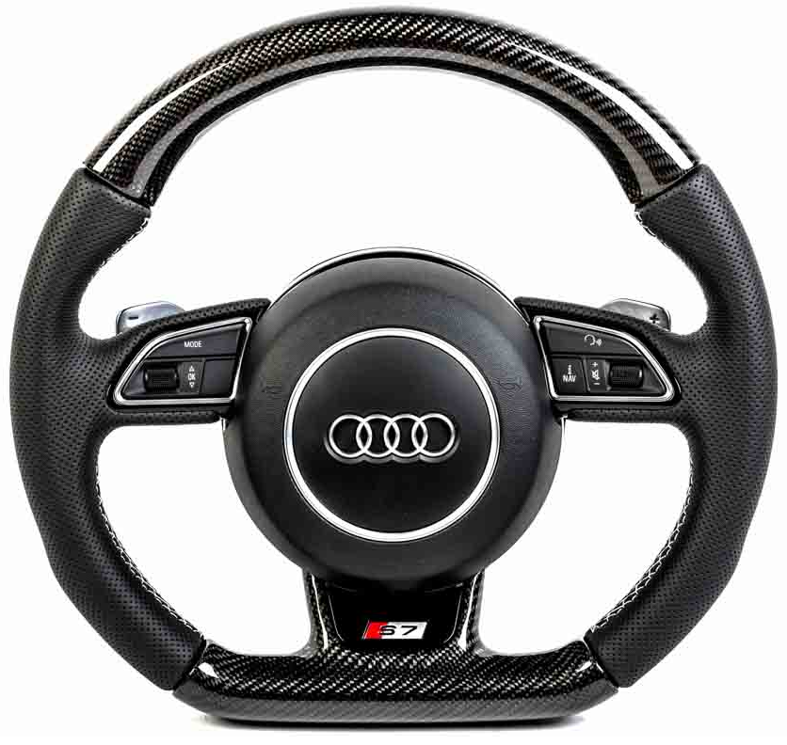
Current Approaches: Behavior Reflex
direct mapping of:
Image-input
steering angle
good for simple, bad very poor for complex tasks
Notes:
Behavior reflex:
Map input to angle

Slide 11
Overview
1.
(Convolutional) Neuronal Nets
2.
Current Approaches
3.
Direct Perception Approach
4.
Deep Learning Languages
5.
Training and Test
6.
Summary

Slide 12
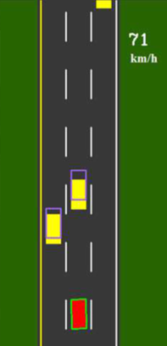
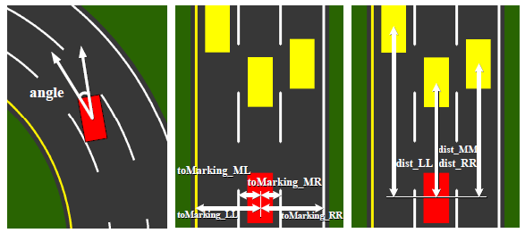
Die Direct Perception
hybrid of: mediated und behavior
13 affordance-values
minimalistic modelling
Notes:
Direct Perception:
Hybrid
13 values: line distance, car distance, angle
2D
Distance guessing (also based on prev.)

Slide 13


Die Direct Perception
Highway driving scenarios
distinguish 2 situations:
Inactivity of currently irrelevant values
in lane
on marking
Example:
No cars on „right“ lane
No cars on “left” lane
But: distance to right lane
Notes:
Made for highway driving
2 situations
active/inactive
Controller

Slide 14
Overview
1.
(Convolutional) Neuronal Nets
2.
Current Approaches
3.
Direct Perception Approach
4.
Deep Learning Languages
5.
Training and Test
6.
Summary

Slide 15
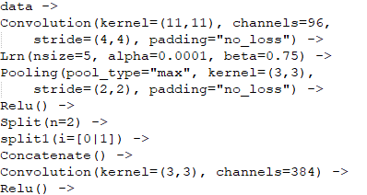
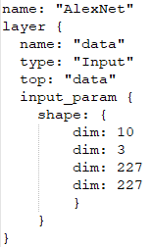
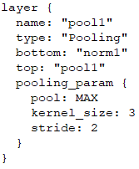
Deep Learning Languages
Different languages to model those CNNs:
CNNArchLang:
part of the MontiCore language family
uses the MxNet framework
Python like Syntax
Caffe:
specialized on modularity, speed and expressiveness
huge community
very verbose through Protocol Buffers
Notes:
CNNArchLang:
Till Timmermanns in his Master Thesis
Connector and Component
Not a framework itself
Caffe:
Long-established
Huge community
Google Protocol Buffers
One net: CNNArch 36 lines vs. Caffe 6700 lines

Slide 16
Overview
1.
(Convolutional) Neuronal Nets
2.
Current Approaches
3.
Direct Perception Approach
4.
Deep Learning Languages
5.
Training and Test
6.
Summary

Slide 17
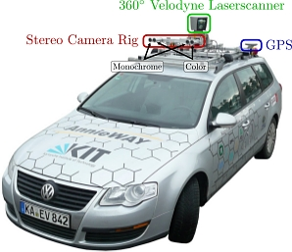
Training
Problem: very specific datasets
TORCS: The Open Racing Car Simulator
KITTI Dataset: 6 hours drive recording
different cameras and views
Additional measurements
Approach A:
stereo RGB camera
Approach B:
mono greyscale camera
distance laser sensor
Testset A
Testset B
Notes:
Problem of specific testsets
TORCS:
Get every value you want
Drawback: no noise, disturbance, Pedestrians, …
Kitti:
Many used options

Slide 18
Overview
1.
(Convolutional) Neuronal Nets
2.
Current Approaches
3.
Direct Perception Approach
4.
Deep Learning Languages
5.
Training and Test
6.
Summary

Slide 19
Summary
Direct perception:
better than behavior reflex (based on TORCS)
as good as mediated perception (based on KITTI)
But: what about more complexity?
CNNArchLang:
simplistic language design (python-like)
elegant definitions of CNNs
through MxNet: SLI and Cluster usage
drawbacks:
no recurrent neural nets
missing set of pre-trained models
documentation
Notes:
Direct Perception:
proven handle highway
Complex tasks?
Signs
Pedestrians
Other faster cars
CNNArch:
Well suited
Highly efficient and scalable (MxNet)
Few minor problems (ok since new)

Slide 20
Fin.
Thank your for your attention

